Slide 1
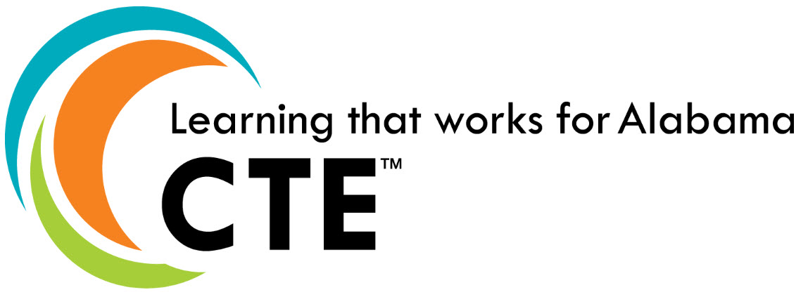
Career and Technical Education Finance Session Prepared for the Superintendents Academy June 26, 2023

Slide 2
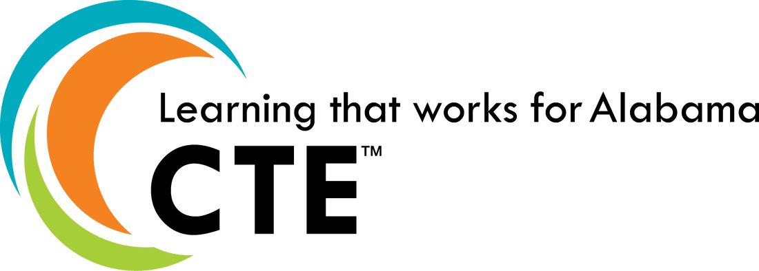
2023 Legislative Session
Governor Ivey’s FY24 Budget
CS4AL: +$3M (100% increase)
CTI: +$11M (includes 70 new career coaches)
JAG: +$1.5M (48 {8 new} programs at $75K)
CCR Grants: $15M (new)
O&M: $8M (level)

Slide 3
2023 Legislative Session
HB109 | To create the Alabama Credential Quality and Transparency Act

Slide 4
2023 Legislative Session
HB164 | To require students to complete a personal financial literacy course before graduation; creation and administration of a financial literacy examination; and to require the reporting of a summary of examination results to the ALSDE

Slide 5
Career Coaches (State)
Career Tech CTE Director / Counselor (State)
Guidance & Counseling (State)
JAG (State)
Technology Centers That Work (State)
Simulated Workplace (Federal)
Middle Grades Expansion(State)
Academy of Craft Training (State)
Credentialing (Federal)
Career Tech Initiatives

Slide 6
Alabama’s Career Clusters

Slide 9
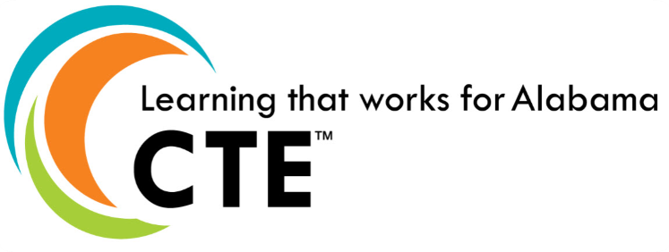
CTE Funding Sources Carl D. Perkins (Basic Grant) Federal funds received annually by each LEA based on a federal formula. Funds dispersed by LEA to CTE programs for program improvement and expansion (NOT program maintenance - consumables). CTE Operations & Maintenance State legislative funds provided for teachers to be used for consumable materials and supplies. May be used for materials, supplies, textbooks, or anything related to CTE student instruction. Varies annually based on the number of teachers in the state. With SDE approval, O & M may be pooled by several teachers to buy a large item related to student needs. Local Education Required Maintenance Local funds required by AL Code $300 plus $3 per student based on last year’s reported rolls. May be used for supplies, books, equipment maintenance, equipment. 290-6-1.08 Code of AL

Slide 10
Carl D. Perkins-Basic Grant Federal Funds
FY 2023 Perkins Allocation - $24.2M
Expands Commitment to Equity
promote equity in CTE through data analysis, funding, technical assistance, professional development and regular engagement of stakeholders representing learners with special population status
Opens Access to Middle Grades (5-8)
Allowable Expenses & Non-Allowable Expenses Using Perkins Funds
Notes:
A bit of recent history . . .
The Strengthening Career and Technical Education in the 21st Century Act (SCATE, or Perkins V) was signed into law in July of 2018.
SCATE reauthorized and significantly revised The Carl D. Perkins Career and Technical Education Act of 2006.
2019-20 was a transition year between Perkins IV and Perkins V.
Alabama’s Four Year State Plan for Perkins Implementation was approved by the U.S. Department of Education in 2020.
Full implementation of Perkins V began July 1, 2020.

Slide 11
Perkins Funding
As specified in the Act, Perkins V Title I funds allocated to the state are distributed among three categories:
85 percent – those provided to eligible recipients through formula-based distribution.
10 percent – those used for state leadership activities.
5 percent – those used for state level administration of the grant.
In the Alabama State Plan, sub-recipients are local LEAs that serve CTE programs at the secondary and postsecondary levels. These sub-recipients receive the 85 percent formula-based allocations.
The funds allocated to the formula-based distribution category are split between secondary and postsecondary eligible recipients as described in the State Plan. All funds that are not used in the fiscal year awarded are recaptured and reallocated through the formula.
Formula Distribution
Eighty-five percent of the Perkins state allocation flows to the Alabama LEAs by formula distribution. This 85 percent is further subdivided into the basic allocation (90 percent of the 85 percent) and the Reserve (10 percent of the 85 percent). Under Perkins V law, states can increase Reserve funds up to 15 percent of the basic allocation. Note: states determine whether reserve funds are awarded and at what level.

Slide 12
Calculations for the Basic Grant are based on specific attributes of the secondary and postsecondary constituents. While the dates of gathered data will change to utilize the most recent information, the basic formula remains constant. Alabama distributes 70% of the 85% to Secondary recipients and 30% to Post-Secondary recipients.
Secondary Formula (Sec 131)
The secondary formula is based 30% on population and 70% poverty. Thirty percent of the secondary allocation is based on the following:
District population of individuals aged 5-17 compared to
State population of individuals aged 5 -17
Seventy percent of the secondary allocation is based on the following:
District population of individuals aged 5-17 in poverty compared to
State population of individuals aged 5-17 in poverty
Results for each district are multiplied by the total secondary formula amount for Alabama from the Office of Career, Technical, and Adult Education (OCTAE) allocation. The secondary LEA formula equals the sum of the amounts calculated for each district member in the LEA.
LEAs Basic Allocation

Slide 13
Monitoring
CTE will follow the Federal Programs monitoring schedule to monitor the utilization of Perkins V funding. Furthermore, TAPE will serve as the evaluation tool required by law to evaluate how activities carried out improves the CTE program.
CTE Directors, LEA Superintendents and CSFOs are responsible for ensuring all Perkins V expenditures adhere to the following items:
The funding is for the purpose of development, implementation, refinement, or support of an approved CTE program or Program of Study.
Funding is allocable according to the Perkins V Act.
There is no supplanting. You cannot use federal funds to pay for equipment, staff, programs, or materials that would otherwise be paid for with state or local funds. In other words, the expenditure was not previously funded with local funding OR is not a state mandate.
The expenditure is reasonable and necessary for the plan’s execution.

Slide 14
Supplement versus supplant is a frequent question. Section 211(a) of Perkins V clearly states: ‘‘SUPPLEMENT NOT SUPPLANT—Funds made available under this Act for career and technical education activities shall supplement, and shall not supplant, non-federal funds expended to carry out career and technical education activities. “Perkins funds shall supplement, not supplant (replace), non- federal funds expended for CTE. If an activity is, or has been, supported by non-federal funds, Perkins funds may not be used to support that activity unless there is overwhelming evidence that the activity would be terminated if federal funds were not available.
Seek state advice before proceeding under this exception. If the LEA would normally pay for an item, service, or activity, then Perkins dollars should not be used.
Supplanting

Slide 15
My career tech center has an automotive program. Can we buy this?

Slide 16
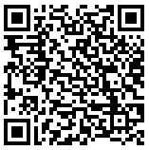
Allowable and Unallowable Uses of Funds
How can we spend our Perkins funding?
RESOURCE: The Alabama CTE Perkins Operational Handbook - https://alabamactso.org/wp-content/uploads/2020/07/Alabama-Perkins-V-Handbook-2020.pdf

Slide 18
Overarching Considerations
The expenditure must be reasonable and necessary.
The expenditure must be on the LEAs Comprehensive Local Needs Assessment (CLNA).
The expenditure must be on the allowable usage list.
The expenditure must be in eGAP coded correctly.
When in doubt, please ASK.

Slide 19
State Funds
All Operations and Maintenance funding amounts are based upon the number of teachers your system coded CTE in LEAPs for the preceding school year. JROTC teachers belong to and are coded to CTE in LEAPs and receive the O & M allocation for their use.
Funds are intended to provide the consumable materials for which federal dollars cannot be used, such as materials and supplies, textbooks, or anything related to CTE student instruction.
Approval to spend O & M on a large item (such as a greenhouse) will be approved on a case-by-case basis by Dawn Morrison. O & M is now a line item in the budget, so please ensure that the funds are dedicated to student needs.
Operations & Maintenance

Slide 20
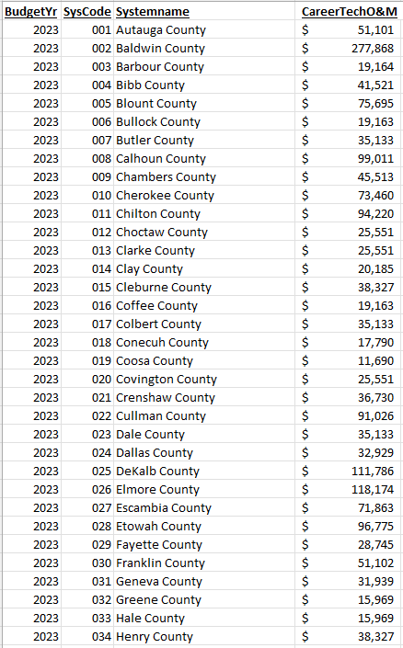
Sample Operations & Maintenance Allocations

Slide 21
LEA Funds: $300 & $3.00*
Funds provided to CTE Programs by the Local Board as required by state code
Counts towards local Maintenance of Effort for CTE
*$300 per teacher +
$3.00 per student in each class based upon the previous year’s 40
day enrollment count
Local Maintenance Funds

Slide 22
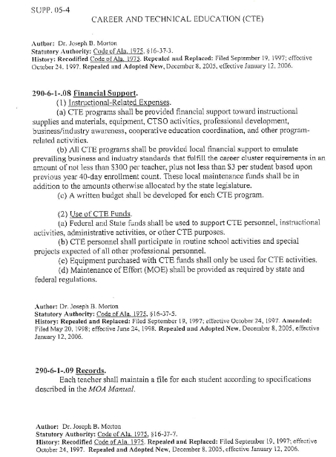
AAC CTE Financial Support

Slide 23
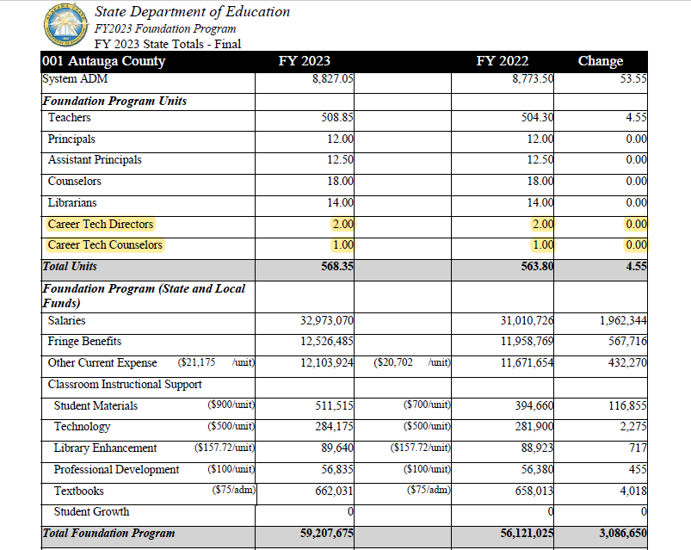
Sample Foundation Program

Slide 24
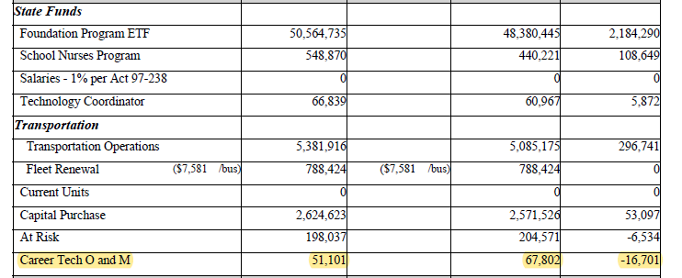
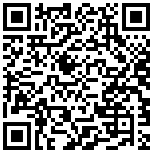
Sample Foundation Program
Career Tech O&M
FY2023 Foundation Program By District

Slide 25
New CTE Administrators Academy September 12-14, 2023 Alabama Association of School Boards

Slide 26
Questions

Slide 27
Thank You
Office of Career and Technical Education/Workforce Development
Dawn Morrison Education Administrator II dmorrison@alsde.edu 334.694.4762
Jimmy Hull, Ed.D Assistant State Superintendent for Career and Technical Education and Workforce Development jimmy.hull@alsde.edu 334.694.4907

